Slide 1
Paediatric Allergy
GP gateway
Dr Anjli Jethwa
MBCHB MRCPCH MSc Allergy
Paediatric Consultant with Allergy interest
Anjli.Jethwa@uhcw.nhs.uk

Slide 2
Objectives
Taking an allergy focused history
When to request allergy tests
Assessment of eczema with suspected allergies
Assessment of urticaria
Assessment of allergic rhinitis

Slide 3
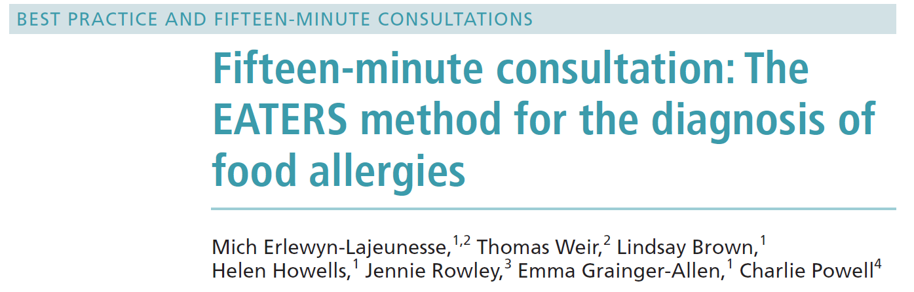
Allergy focused history
BMJErlewyn-Lajeunesse
M, Weir T,
Brown L, et al. Arch
Dis Child Educ Pract Ed
2019;104:286–291.
https://ep.bmj.com/content/104/6/286

Slide 4
Allergy focused history
E
A
T
E
R
S
Exposure
Allergen
Timing
Environment
Reproducible
Symptoms
Past medical history of atopy
Family history of atopy
Notes:
Exposure – consumption of food allergen; allergen – common known food allergen; timing between exposure and onset of symptoms; environment – where food allergic reactions are more common; reproducible – symptoms, previous and future exposures to the same allergen; symptoms – typical for allergic reaction involving multiple organ systems.

Slide 5
IgE mediated
E - eating, or occasionally by skin contact, or rarely inhaled
A – milk, egg, peanut, tree nut, sesame seed most common
T – symptoms occur within 1 hour of ingestion, during weaning or at first known exposure
E - allergen is new part of diet
R - always has symptoms with exposure, “gap” in regular consumption
S – skin – urticaria, angioedema
gut – vomiting and abdominal pain, diarrhoea
respiratory – acute onset cough, wheeze, stridor, clear rhinorrhoea
neurological – sleepiness, impending doom, anxiety
cardiovascular – collapse, shock
Red flags - anaphylaxis

Slide 6
Non-IgE mediated
E - cow’s milk formula fed, or breast fed with regular exposure through mother’s milk
A – milk and soya most common
T – symptoms occur 1-24 hours after ingestion, in first year of life, onset can be insidious
E - allergen is a regular part of the diet or of the mother’s diet if breast fed
R - symptoms may take time to settle on an exclusion diet, 2-14 days, symptoms return on reintroduction of allergen within 6 weeks
S – skin – eczema
gut – vomiting, reflux, dysphagia, food bolus impaction, colic, abdominal pain, diarrhoea or constipation, mucous/blood in stools
respiratory – chronic catarrh, cough, persistent clear rhinorrhoea
Red flags – vomiting and diarrhoea leading to shock (FPIES); faltering growth

Slide 7
Allergy tests
IgE food allergy – focused testing based on history
  Serum spIgE (components)
  Skin Prick Test
Non-IgE food allergy
  No blood test
Not recognised allergy tests
  vega testing
  applied kinesiology
  hair analysis
  serum-specific IgG testing
Notes:
Vega testing is also called Electro Acupuncture, according to Voll or EAV testing. It uses the acupuncture points in the hands as access points to your body's sensitive electromagnetic system. From there, the machine measures electromagnetic fluctuations in your body in response to testing various elements.

Slide 8
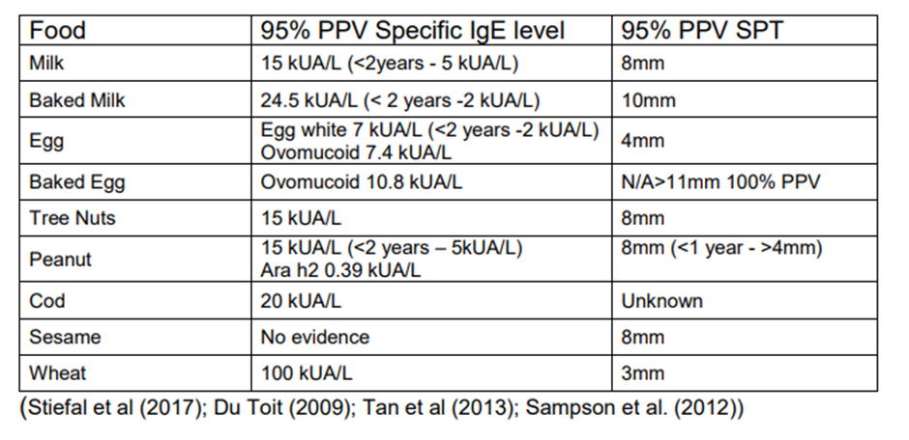
SPT / spIgE
Wheal size ≥3mm SPT, spIgE >0.35, positive tests but poor predictor of relevant food allergy
The 95% PPV is the cut off level above which 95 out of 100 children would be expected to have a reaction.

Slide 9
Prognosis of food allergy
Most children will outgrow milk, egg, soya allergies by school age
  Tolerates baked forms and progress along ladders
Other food allergies tend to be lifelong
20% of children can outgrow nut allergy
Ongoing management to support Health Transition
  Practical Ps for Allergy Patient (BSACI)
  Ready Steady Go website
  11 to 25 Hub website

Slide 10
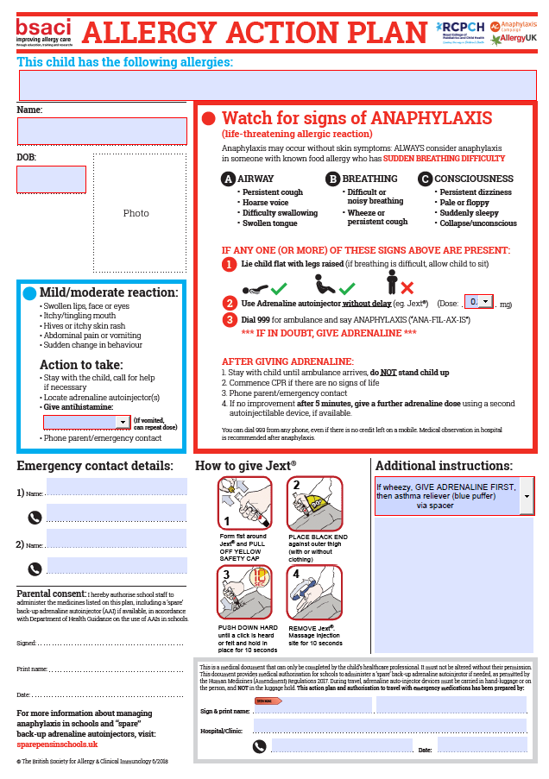
Management of IgE food allergy
Different stakeholders
    Patient
    Family
    School
    Food industries
    Government

Slide 11
Mild/moderate reaction:
Swollen lips, face, eyes
Itchy/tingling mouth
Hives or itchy skin rash
Abdominal pain or vomiting
Sudden change in behaviour
Action to take:
Stay with the child, call for help if necessary
Locate adrenaline auto-injector(s)
Give antihistamine
Phone parent/emergency contact
Notes:
High risk groups: co-morbidities, teenagers with risk taking behaviours, alcohol, exercise, stress. Non sedating antihistamines Piriton less than 2 years, cetirizine for 2 year olds and over.

Slide 12
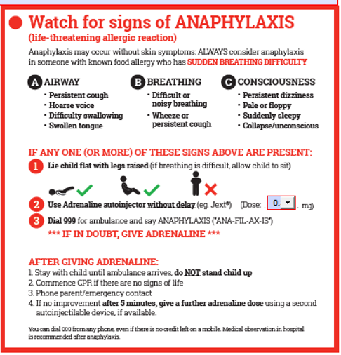
Notes:
High risk groups: co-morbidities, teenagers with risk taking behaviours, alcohol, exercise, stress. Dose of 300mcg when children 25kg or above, carry at all times. Mandatory for previous anaphylaxis; recommended for IgE food allergy and unstable asthma.

Slide 13


Management of IgE food allergy
Different stakeholders
    Patient
    Family
    School
    Food industries
    Government
Notes:
Register for expiry alerts, videos on administration, trainer pens. Carry at all times. Service audit, 50% do not carry, supporting good behaviours. Practice monthly. Register for expiry alerts.

Slide 14

Management of IgE food allergy
Different stakeholders
    Patient
    Family
    School
    Food industries
    Government
Bennedict’s Law (School Allergy Safety Bill)
Mandatory in date AAI, comprehensive allergy training, individualised care plans
Notes:
Encourage schools to purchase own generic AAI
Key Components and Status:
Core Requirements: Mandatory, in-date adrenaline auto-injectors (AAIs) in all schools, comprehensive staff allergy training, and clear, actionable, whole-school allergy policies, including individualized care plans for pupils.
Progress: As of February 2026, the UK government has committed to new, mandatory statutory guidance on managing allergies in schools following a successful amendment in the House of Lords.
Context: The campaign, led by the Benedict Blythe Foundation with support from allergy charities, aims to address the inconsistent"postcode lottery" approach to allergy safety in schools.

Slide 15
Management of IgE food allergy
Different stakeholders
    Patient
    Family
    School
    Food industries
    Government
The 14 allergens are: celery, cereals containing gluten (such as barley and oats), crustaceans (such as prawns, crabs and lobsters), eggs, fish, lupin, milk, molluscs (such as mussels and oysters), mustard, peanuts, sesame, soybeans, sulphur dioxide and sulphites (if they are at a concentration of more than ten parts per million) and tree nuts (such as almonds, hazelnuts, walnuts, brazil nuts, cashews, pecans, pistachios and macadamia nuts).
Notes:
May contain traces labelling, needs caution but no need to avoid completely. Beware of outside of UK

Slide 16
Management of IgE food allergy
Different stakeholders
    Patient
    Family
    School
    Food industries
    Government
Legislation which mandates full ingredients labelling for foods which are prepacked for direct sale.
On October 1st 2021 a new law on allergen labelling, known as “Natasha’s Law”, came into force in the UK. The new law says that food, freshly prepared, then packaged and displayed before being sold, has to have a label listing full ingredients and highlighting any of the 14 major allergens it contains.
Bennedict’s Law February 2026 – School Allergy Safety Bill
Notes:
Care when travelling abroad, translator apps, insurance, carrying medications on board aircraft. Cross contamination.

Slide 17
Useful Websites
www.anaphylaxis.org
www.allergyuk.org
http://itchysneezywheezy.co.uk/
www.bsaci.org
https://www.eczemacareonline.org.uk
https://www.sparepensinschools.uk/
Readysteadygo
www.11to25hub.com
Bsaci Practical Ps for Allergy Patients https://www.bsaci.org/about-bsaci/bsaci-council-and-executive/bsaci-subcommittees/adolescents-and-young-adults-resources-practical-ps/
https://www.food.gov.uk/news-alerts
JEXT: https://kids.jext.co.uk/
EPIPEN: http://www.epipen.co.uk/patients/

Slide 18
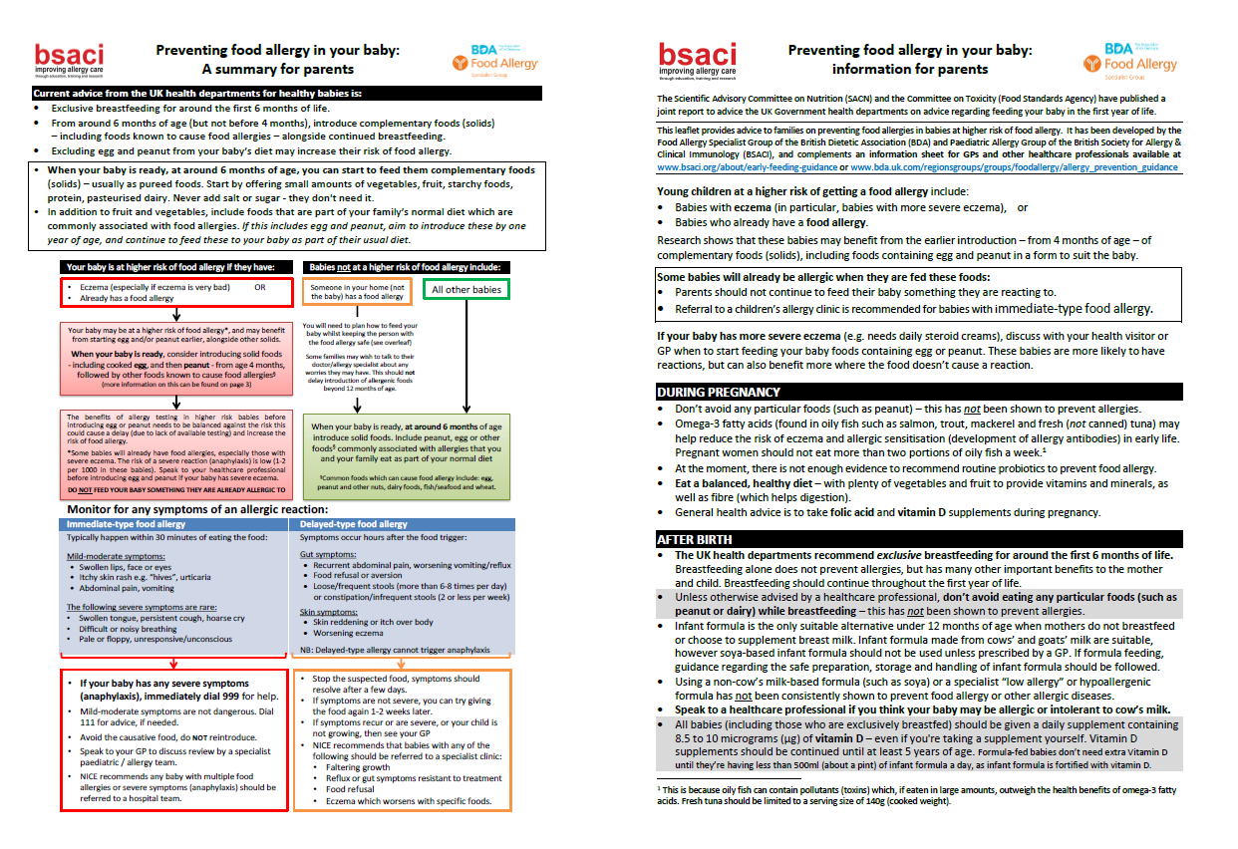
BSACI – preventing food allergy
https://www.bsaci.org/wp-content/uploads/2020/02/pdf_Infant-feeding-and-allergy-prevention-PARENTS-FINAL-booklet.pdf

Slide 19
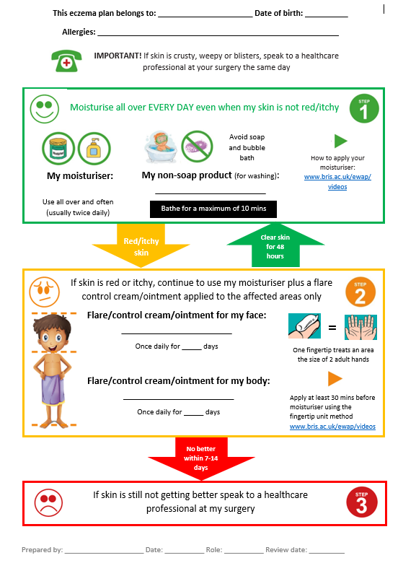
Eczema written plan

Slide 20
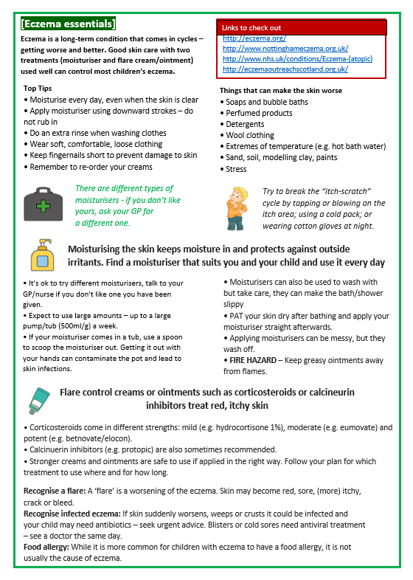
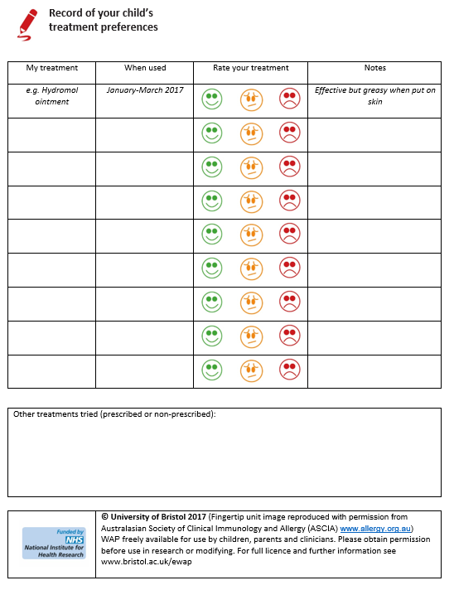
Eczema written plan

Slide 21
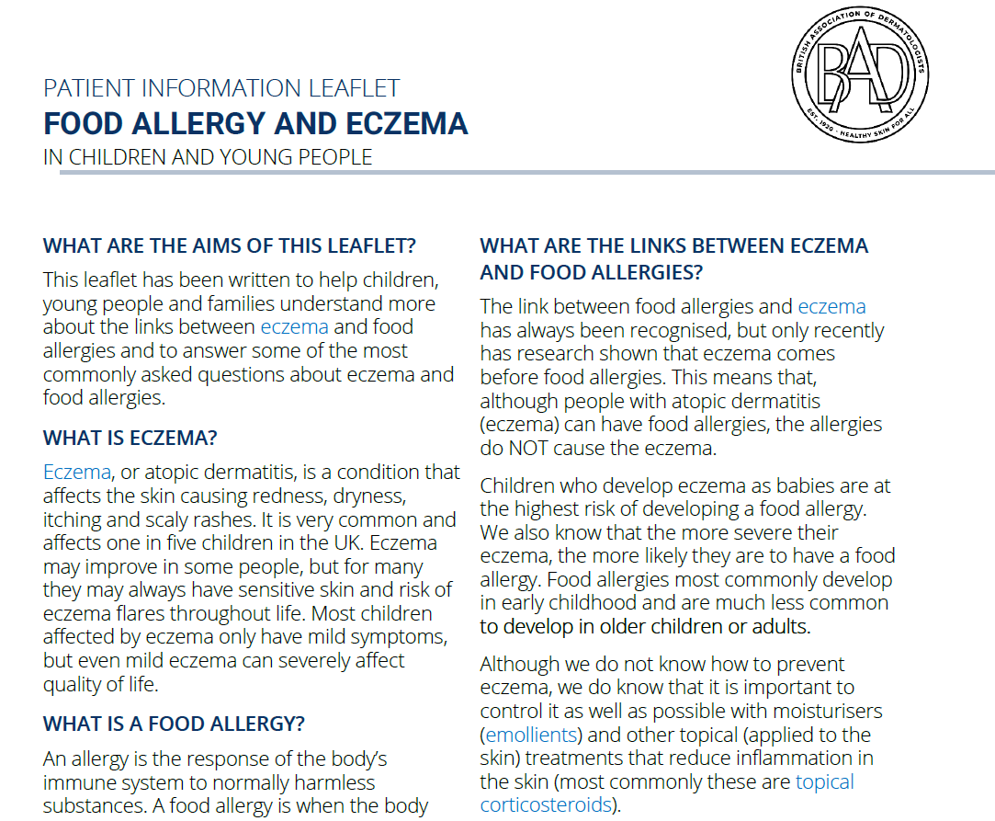
Patient information leaflet
https://www.skinhealthinfo.org.uk/wp-content/uploads/2024/06/Food-allergy-and-eczema-PIL-June-2024.pdf

Slide 22
Approach to urticaria
Chronic Spontaneous Urticaria
  Daily symptoms for 6 weeks or more
  Can be associated with angioedema
  CRUSE app https://ucare-network.com/cruse-chronic-urticaria-self-evaluation-app/
  25% are disease free after 3 years, 90% after 7 years
  Most respond to non-sedating antihistamines
  Investigations: FBC, ferritin, TFTs, antithyroid antibodies, LFTs, coeliac screen, urinalysis (C3/C4 only if urticaria is not pruritic)
  Management: daily non-sedating antihistamines, dose can be doubled (x4 dose under specialist supervision); consider montelukast (informed decision, BNFc product information leaflet)

Slide 23
Approach to urticaria
Acute intermittent
  Physical (cold, pressure)
  Viral illnesses
  Food triggers
  It’s all in the history!

Slide 24
Allergic march
Notes:
Cannot predict which children will follow the timeline.

Slide 25
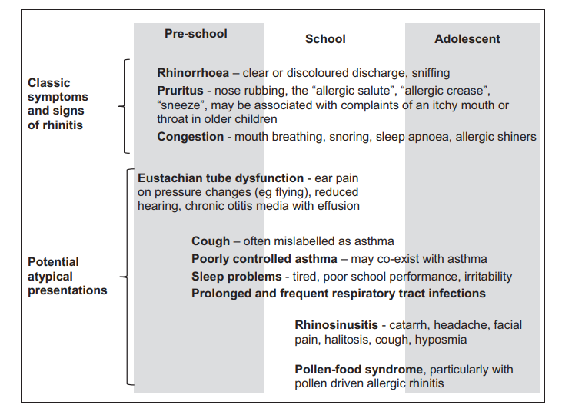
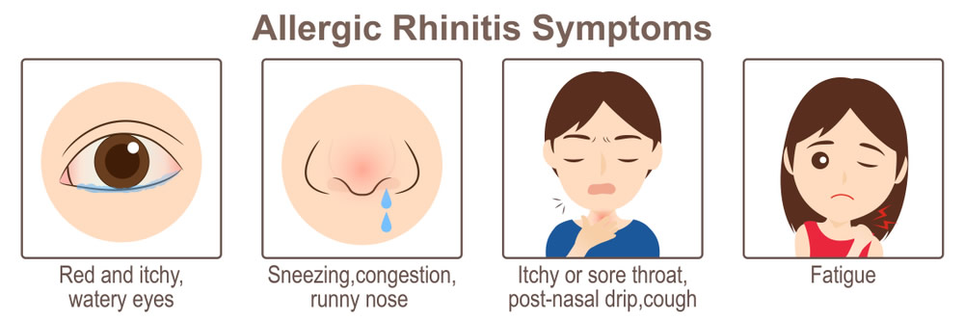
Assessment of Rhinitis
Notes:
Affects 1 in 4 in the UK, more common in Westernised societies
Rhinitis – inflammation of the lining of the nose
Allergic rhinoconjunctivitis - seasonal or perennial
Implicated as risk factor for asthma, otitis media with effusion and sinusitis
Impairs sleep, QoL, school performance and attendance at work
Diagnosis – adequate history, examination, if necessary specific allergy test

Slide 26
Assessment of rhinitis
  Allergic
  Non allergic
  Infective

Slide 27
Non-allergic
Non-allergic rhinitis with eosinophilia
Autonomic/vasomotor
Drugs (beta blockers, chlorpromazine, cocaine, nasal decongestants, NSAIDs)
Hormonal
Food (alcohol, spicy foods, peppers)
Atrophic
CF, Primary Ciliary Dyskinesia
Systemic/inflammatory
Immunodeficiency

Slide 28
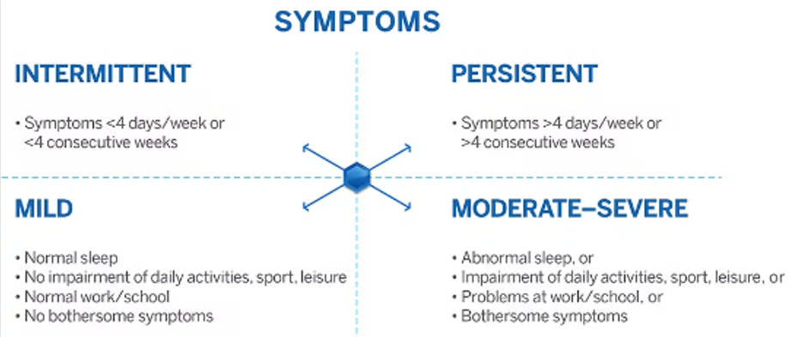
Assessment - history
Notes:
Home environment, travel to work/school, pets, carpets, cuddly toys, mould, smoking, pollution

Slide 29
Assessment - examination
General assessment (including growth parameter, systemic examination)
Allergic salute/horizontal nasal crease
Chronic mouth breathing
Allergic shiners
Depressed nasal bridge – red flag
Widened nasal bridge – red flag
Purple nasal tip – red flag
Anterior rhinoscopy
  Pale, hypertrophied nasal turbinates
  Secretions
  Septum position
  Throat examination
  Polyps – red flag
  Crusting – red flag

Slide 30
Assessment
Referral to ENT
  Unilateral symptoms
  Blood-stained discharge
  Pain
  Structural abnormalities e.g. septal deviation

Slide 31
Management
Nasal washing (Cochrane Database Syst Rev. 2018 Jun 22;6(6):CD012597.)
Drug therapy
  Non-sedating oral antihistamines (cetirizine, loratadine, desloratadine, fexofenadine)
  Topical nasal steroid sprays (Nasonex, Avamys, Dymista, Ryaltris)
  Antihistamine eye drops (olopatadine, sodium cromoglycate)
  Leukotriene receptor antagonists (montelukast)

Slide 32
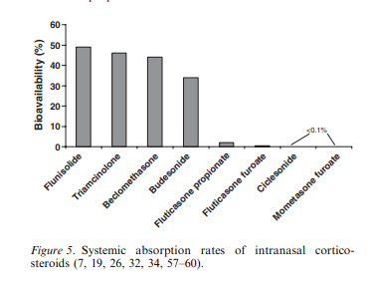
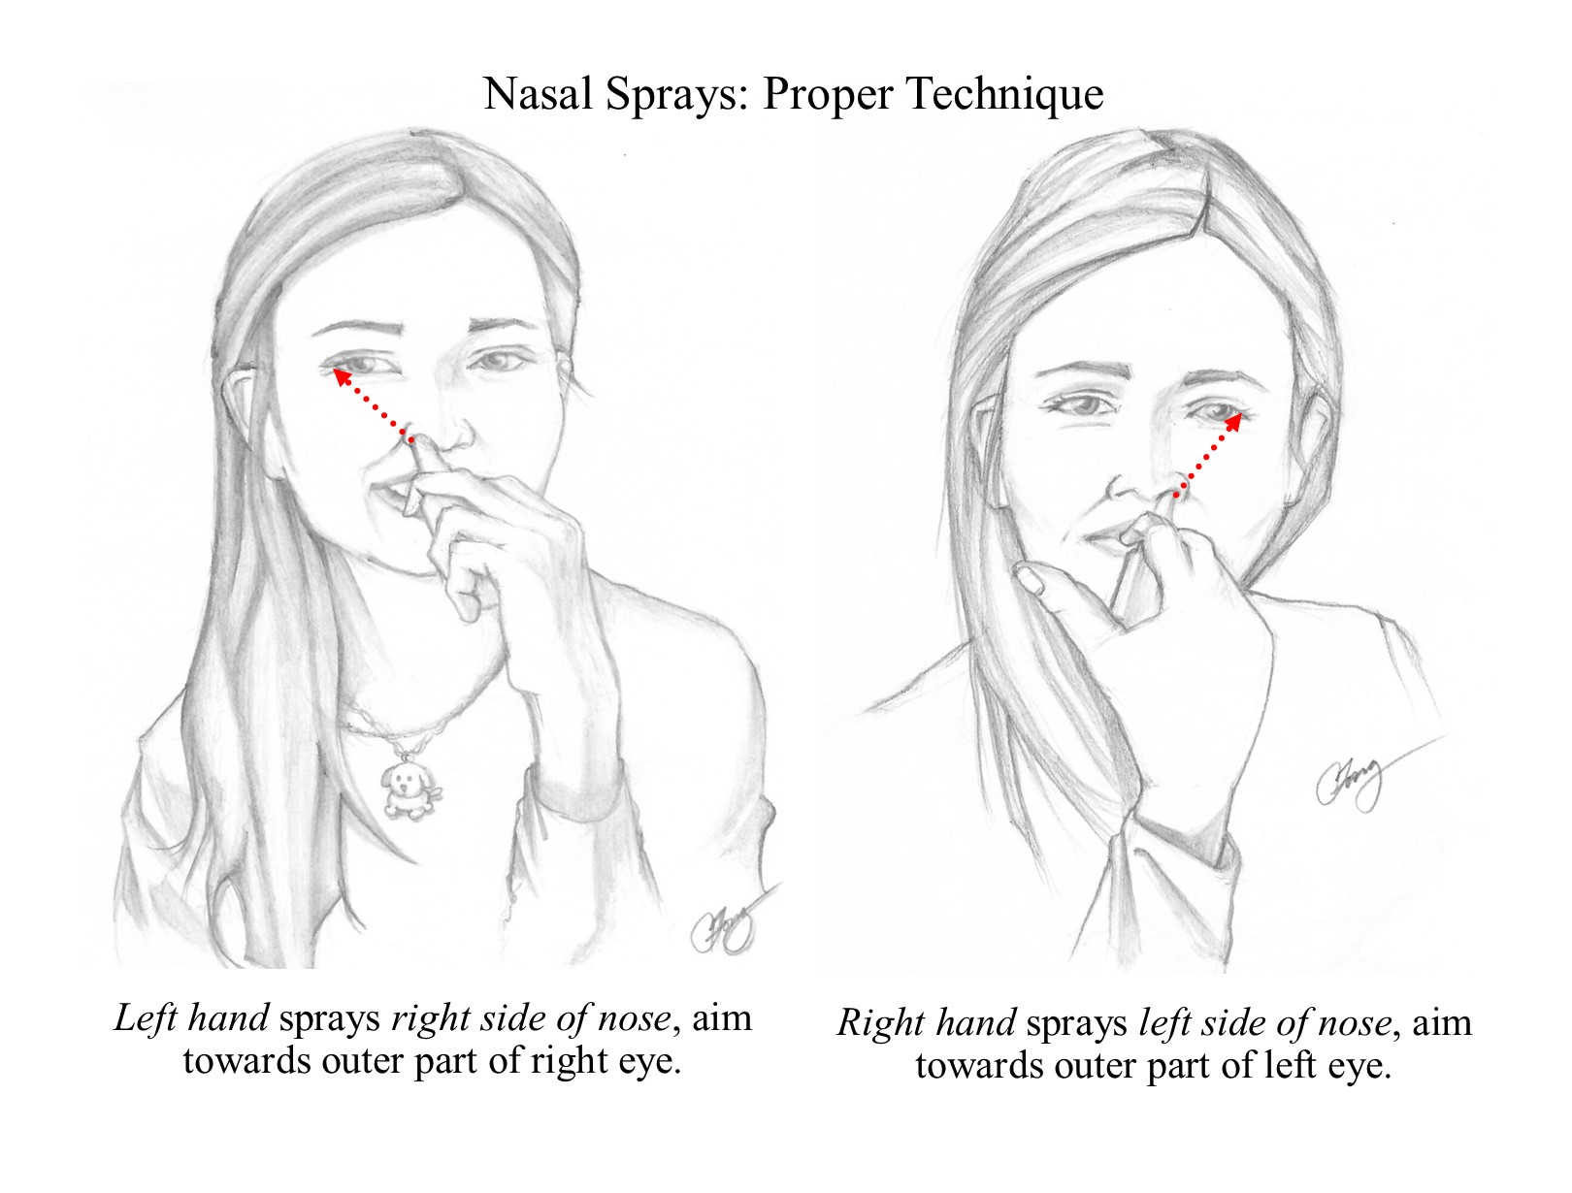
Management
Intranasal corticosteroids
Systemic absorption is higher with older compounds (Derendorf, Allergy 2008: 63: 1292–1300)
Nasonex – mometasone (>3 yo)
Avamys - fluticasone (>4 yo)
Dymista – fluticasone and azelastine (>12 yo)
Ryaltris – mometasone and olopatadine (>12 yo)
Correct administration (https://www.itchysneezywheezy.co.uk/)

Slide 33
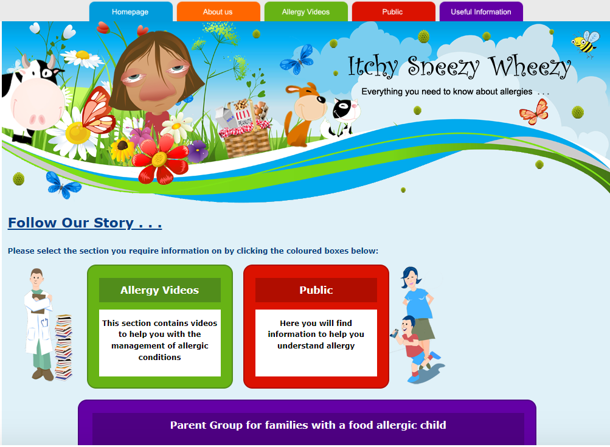
Management
Allergy Care Pathway Itchy Sneezy Wheezy Project - Rhinitis Videos

Slide 34
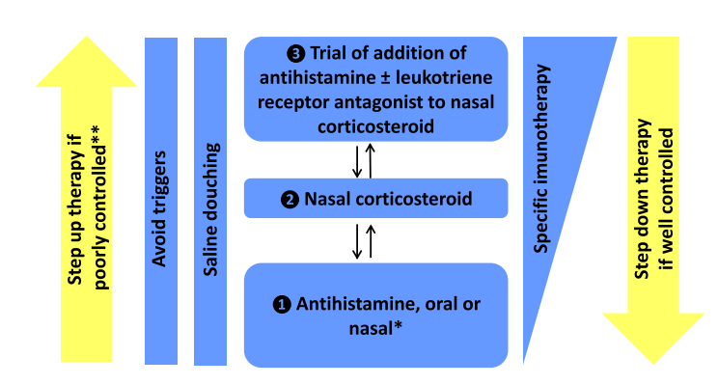
Allergic rhinitis
Notes:
Montelukast – neuropsychiatric side-effects

Slide 35
Immunotherapy
Treatment for children with the persistence of symptoms despite appropriate medications - BSACI (2017) and ARIA (2019)
Moderate/severe symptoms
It is the only treatment which can alter the course of allergic rhinitis, with long-term remission after discontinuation
Refer to local allergy service (BSACI Find a clinic https://www.bsaci.org/public-information/find-a-clinic/)
Grazax/Acarizax

Slide 36
Referral - detail
Situation – Symptoms
Background - Co-morbidities, examination, QoL scores
Action – investigations (spIgE), treatments past and present
Recommendation – immunotherapy

Slide 37
Referrals to allergy clinic
Anaphylaxis
IgE food allergies
FPIES
Chronic Spontaneous Urticaria/angioedema
Venom allergy
Allergic rhinitis unresponsive to standard medical treatment (sublingual immunotherapy grass and house dust mite)
If in doubt send A&G

