Slide 1

Lower GI Pathway Education Webinar to support Primary Care
October 2023

Slide 2
The Case for Change
What’s changed and why

Slide 3
The Case for Change
Studies showing FIT to be effective in detecting CRC where NG12 symptoms present
Revised guidance from BSG
Letter to GP’s
DG56 NICE Guidance Quantitative FIT to guide colorectal cancer pathway referral in primary care
Analogous to CXR for suspected lung
NOTE: It is not a rule in/rule out test – safety netting of patients is key

Slide 4
What’s Changing?
How does it impact GPs?

Slide 5
GP Contract
IIF Requirements
Financial reimbursement

Slide 6
Revised LGI Pathway
FIT test to be completed prior to referral (note clinical exceptions)
Safety Netting
Based on FIT result, GP will refer to:
  Lower GI
  NSS
  Alternative pathway

Slide 7
PATIENT ATTENDS GP, GP CONCERNED ABOUT LGI CANCER
Patient declined/Unable to do FIT
Patient presents with:
Unexplained Rectal Mass
Anal Ulceration/Mass
FIT test Spoilt or not completed
Test not returned
Day 21
Test not returned
Patient reminded (Day 7)
FIT test requested
LGI 2WW REFERRAL MADE
GP to make contact with patient for repeat
FIT results reviewed
GP contacts patient for repeat
POSITIVE FIT RESULT >10 ugHb/g (inc. IDA)
Please ensure the correct FIT code and the 2WW urgent LGI/Colorectal referral code has been added within the correct timelines
NEGATIVE FIT result <10 ugHb/g
Patient reviewed by GP
Remember, especially for young patients with bowel symptoms they may have IBD, hence do a Faecal Calprotectin and if positive refer to the urgent IBD pathway
GP not concerned about a cancer
Patient has IDA
Ongoing NG12 Symptoms
Unexplained PR bleeding
Patient doesn’t require a referral
LGI 2WW REFERRAL MADE
This document requires:
-timely turnaround of FIT results
-an active NSS pathway
-flexi sig pathway
NSS
Referral made
Advice &
Guidance/
Routine referral
LGI 2WW REFERRAL MADE
NSS
Referral made
Direct access Flexi Sig – Cancer Pathway Referral made
Patient safety netted in Primary Care

Slide 8
Supporting Primary Care
How does it impact GPs?

Slide 9
Tips for Primary Care
Discuss and inform patients importance of completing FIT test before onward referral
FIT Patient Information Leaflet Updated 2023 – GP Gateway (coventryrugbygpgateway.nhs.uk)
Inform the patient the FIT testing kit will arrive through the post
As soon as they receive the kit, they should do the sample and return the kit as soon as possible, ideally within 1-2 days.
It important to note the urgency in order that you receive the result as soon as possible allowing the onward referral to be made (if appropriate)
Highlight the patient information leaflet which explains how to take the sample Faecal Immunochemical Testing (FIT) for Occult Blood – GP Gateway (coventryrugbygpgateway.nhs.uk)
If you would like to request FIT kits for demonstration purposes only and to retain within the practice please complete the attached request form found here FIT Demonstration Kit Request for Primary Care 2023 – GP Gateway (coventryrugbygpgateway.nhs.uk)

Slide 10
Supporting Text Messages

Slide 11
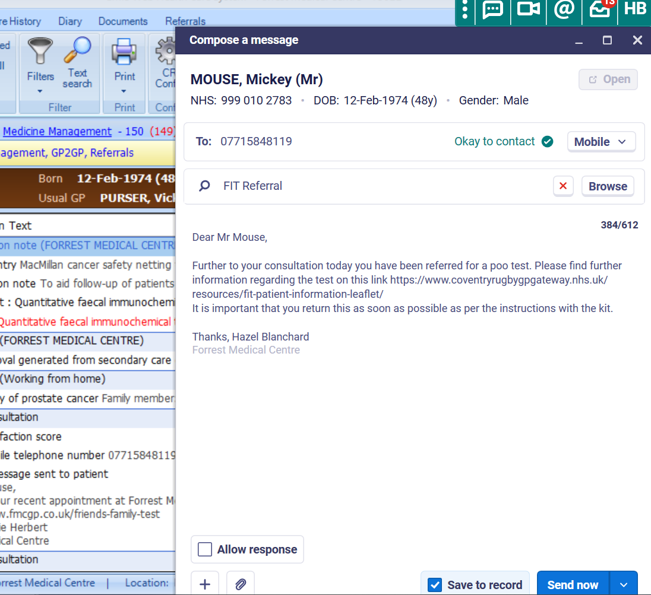
Supporting FIT Text messages prior to a TWW referral
Completed by Admin Team at the practices:
1st standard suggested text wording sent to patient when FIT referral done:
‘Dear X,
Further to your consultation today you have been referred for a poo test. Please find further information regarding the test on this link
https://www.coventryrugbygpgateway.nhs.uk/resources/fit-patient-information-leaflet/
It is important that you return this as soon as possible as per the instructions with the kit.
XXX Practice name’

Slide 12
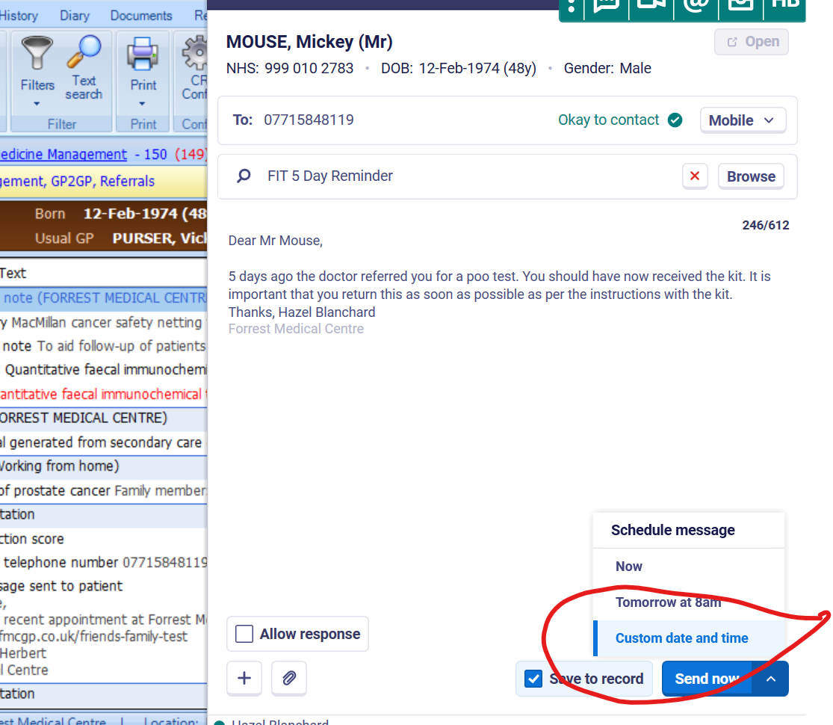
Supporting FIT Text messages prior to a TWW referral
At the same time Admin can custom set another text set for 5 days time:
Day 5 follow up Standard suggested text wording:
‘Dear X,
5 days ago the doctor referred you for a poo test. You should have now received the kit. It is important that you return this as soon as possible as per the instructions with the kit.
XXX Practice name’

Slide 13
What is safety netting and why is it important?

Slide 14
Why is safety netting important?
The non-specific nature of cancer symptoms is a key challenge to early diagnosis
Effective safety netting can:
  Help manage diagnostic uncertainty (‘vague symptoms’)
  Reduce delays*
  Help to diagnose cancer earlier
  Improve survival
  Reduce costs to the NHS
  DES/QOF

Slide 15
Safety Netting Options
EMIS
Arden’s
PCIT

Slide 16
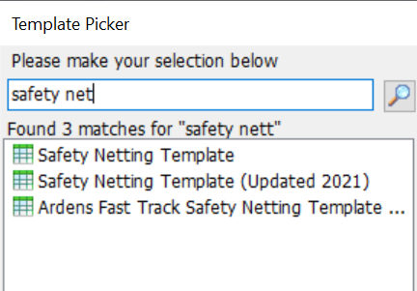
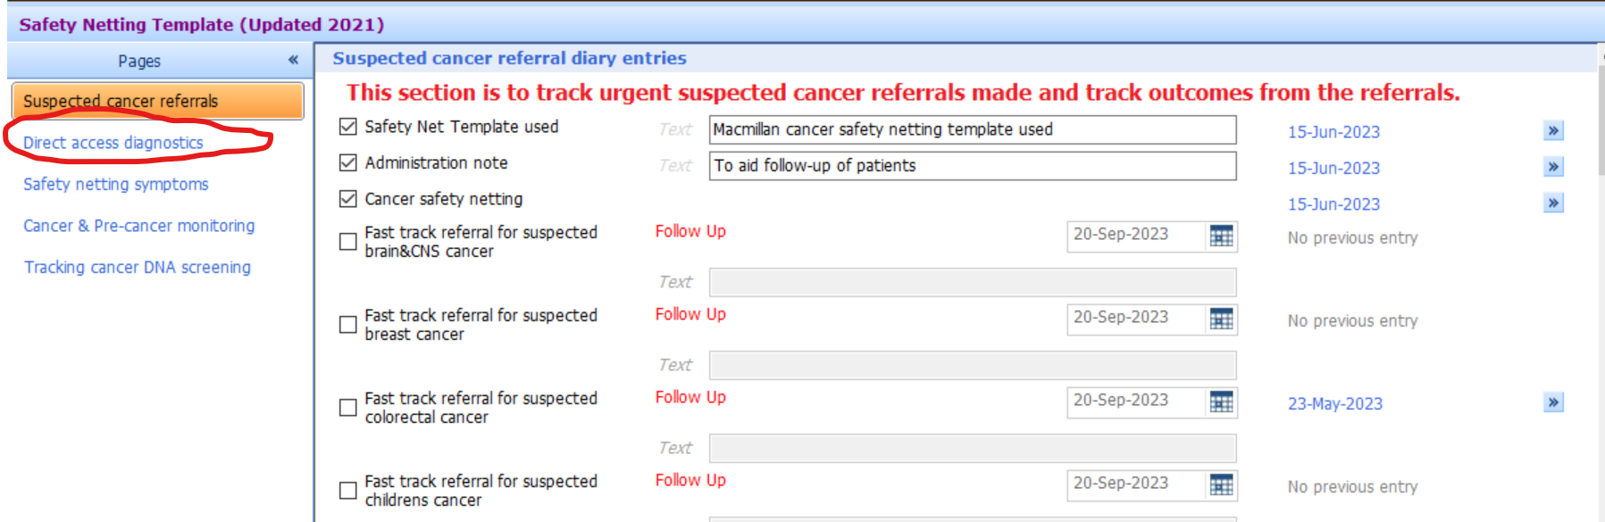

Slide 17
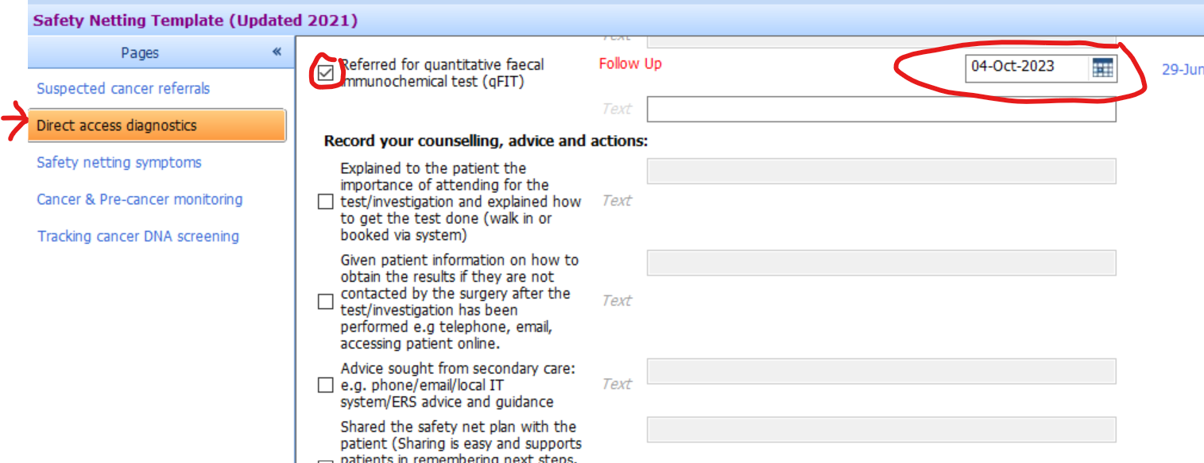
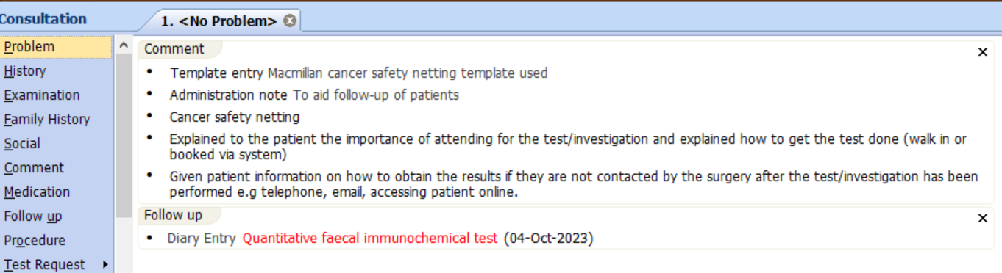

Slide 18
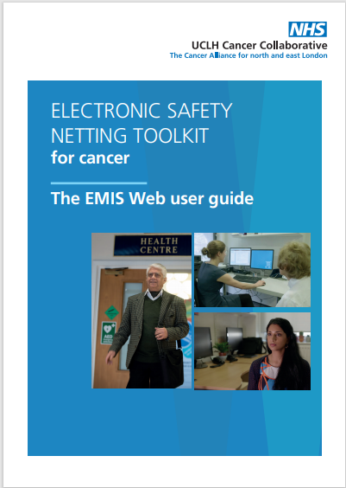
North Central London Cancer Alliance - Electronic Safety Netting Tool
North Central London CA Electronic Safety Netting Tool
The toolkit gives GP practices a template/form that schedules diary reminders in their system and reminds and alerts practice staff to follow up at a later date.
Location of toolkit on EMIS web
Guide for Clinicians
Guide for Admin Staff
Video User Guide

Slide 19
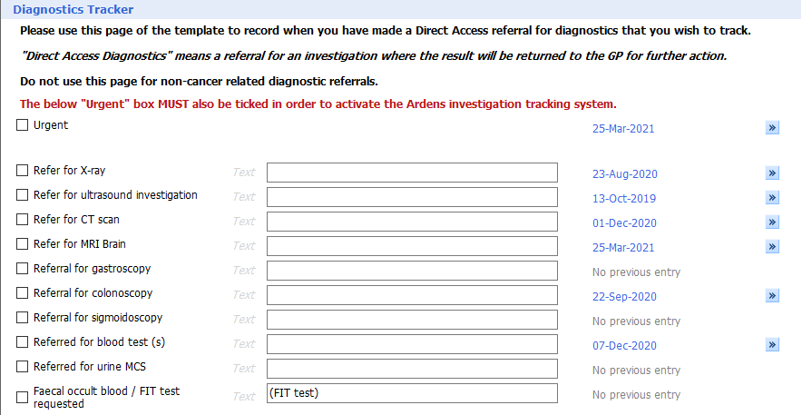
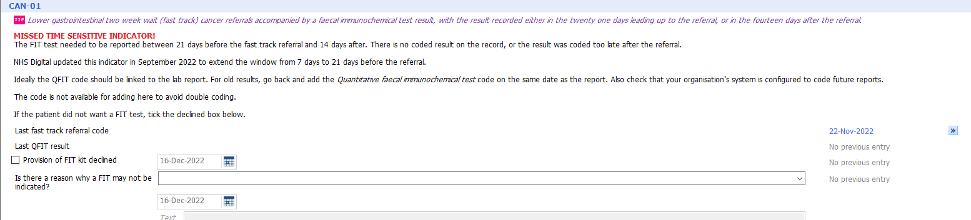
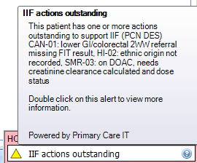
Arden’s / PCIT Safety Netting
Safety netting templates are also in Arden’s and PCIT programmes and enable the user to follow up the FIT and 2WW referral
Ardens
PCIT

Slide 20
Safety Netting
- Ardens
Opens in web browser

Slide 21
Safety Netting
- Primary IT
Opens in web browser

Slide 22
Two important aspects for primary care
1. Fast track referral for suspected lower GI referral
  Follow up – FIT test requested on [insert date]
  Set date to send 2WW referral [2 weeks from now]
2. FIT
  Referred for Quantitative faecal immunochemical test (qFIT)
  Follow up – send 1st text immediately
  Schedule 2nd text in 5 days
  Remember after your FIT result is back your cancer referral will require safety netting

Slide 23
Patient Examples
Two Week Waits

Slide 24
PATIENT ATTENDS GP, GP CONCERNED ABOUT LGI CANCER
Patient declined/Unable to do FIT
Patient presents with:
Unexplained Rectal Mass
Anal Ulceration/Mass
FIT test Spoilt or not completed
Test not returned
Day 21
Test not returned
Patient reminded (Day 7)
FIT test requested
LGI 2WW REFERRAL MADE
GP to make contact with patient for repeat
FIT results reviewed
GP contacts patient for repeat
POSITIVE FIT RESULT >10 ugHb/g (inc. IDA)
Please ensure the correct FIT code and the 2WW urgent LGI/Colorectal referral code has been added within the correct timelines
NEGATIVE FIT result <10 ugHb/g
Patient reviewed by GP
Remember, especially for young patients with bowel symptoms they may have IBD, hence do a Faecal Calprotectin and if positive refer to the urgent IBD pathway
GP not concerned about a cancer
Patient has IDA
Ongoing NG12 Symptoms
Unexplained PR bleeding
Patient doesn’t require a referral
LGI 2WW REFERRAL MADE
This document requires:
-timely turnaround of FIT results
-an active NSS pathway
-flexi sig pathway
NSS
Referral made
Advice &
Guidance/
Routine referral
LGI 2WW REFERRAL MADE
NSS
Referral made
Direct access Flexi Sig – Cancer Pathway Referral made
Patient safety netted in Primary Care

Slide 25
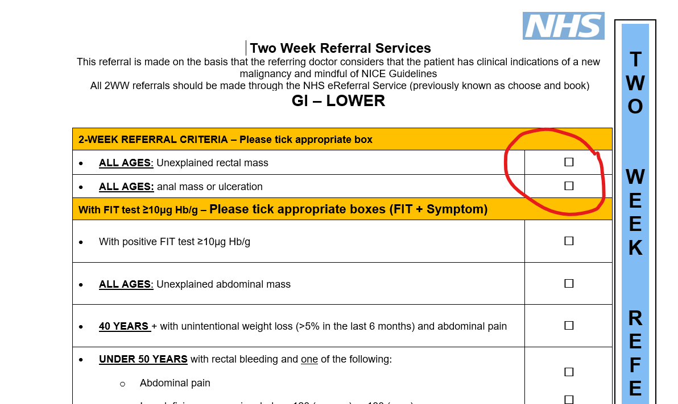

Slide 26
PATIENT ATTENDS GP, GP CONCERNED ABOUT LGI CANCER
Patient declined/Unable to do FIT
Patient presents with:
Unexplained Rectal Mass
Anal Ulceration/Mass
FIT test Spoilt or not completed
Test not returned
Day 21
Test not returned
Patient reminded (Day 7)
FIT test requested
LGI 2WW REFERRAL MADE
GP to make contact with patient for repeat
FIT results reviewed
GP contacts patient for repeat
POSITIVE FIT RESULT >10 ugHb/g (inc. IDA)
Please ensure the correct FIT code and the 2WW urgent LGI/Colorectal referral code has been added within the correct timelines
NEGATIVE FIT result <10 ugHb/g
Patient reviewed by GP
Remember, especially for young patients with bowel symptoms they may have IBD, hence do a Faecal Calprotectin and if positive refer to the urgent IBD pathway
GP not concerned about a cancer
Patient has IDA
Ongoing NG12 Symptoms
Unexplained PR bleeding
Patient doesn’t require a referral
LGI 2WW REFERRAL MADE
This document requires:
-timely turnaround of FIT results
-an active NSS pathway
-flexi sig pathway
NSS
Referral made
Advice &
Guidance/
Routine referral
LGI 2WW REFERRAL MADE
NSS
Referral made
Direct access Flexi Sig – Cancer Pathway Referral made
Patient safety netted in Primary Care

Slide 27
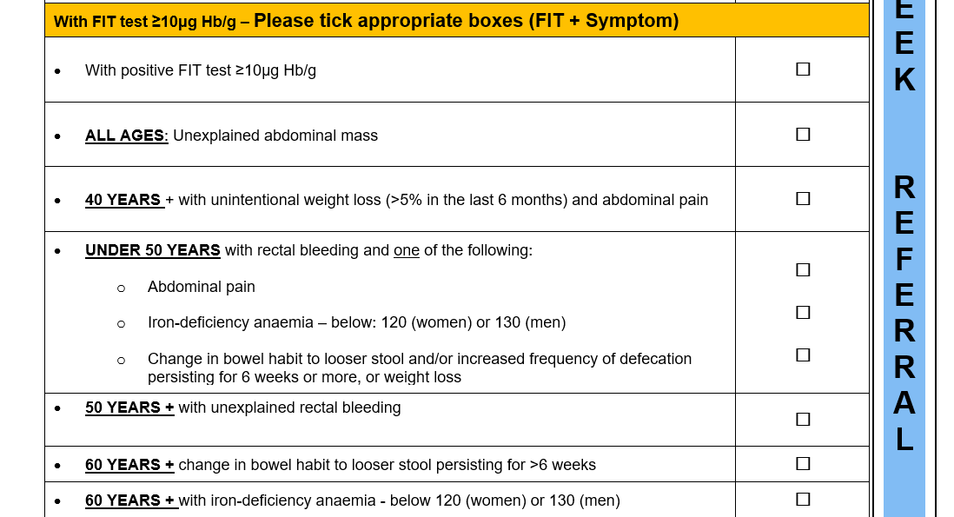
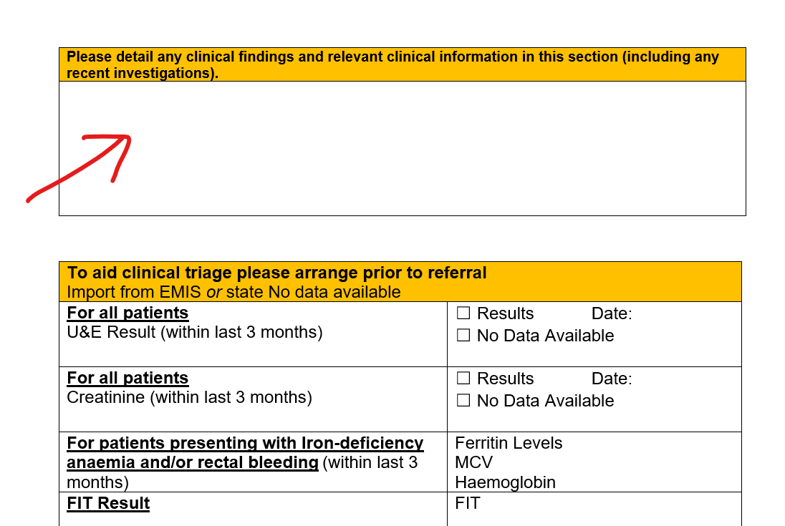

Slide 28
PATIENT ATTENDS GP, GP CONCERNED ABOUT LGI CANCER
Patient declined/Unable to do FIT
Patient presents with:
Unexplained Rectal Mass
Anal Ulceration/Mass
FIT test Spoilt or not completed
Test not returned
Day 21
Test not returned
Patient reminded (Day 7)
FIT test requested
LGI 2WW REFERRAL MADE
GP to make contact with patient for repeat
FIT results reviewed
GP contacts patient for repeat
POSITIVE FIT RESULT >10 ugHb/g (inc. IDA)
Please ensure the correct FIT code and the 2WW urgent LGI/Colorectal referral code has been added within the correct timelines
NEGATIVE FIT result <10 ugHb/g
Patient reviewed by GP
Remember, especially for young patients with bowel symptoms they may have IBD, hence do a Faecal Calprotectin and if positive refer to the urgent IBD pathway
GP not concerned about a cancer
Patient has IDA
Ongoing NG12 Symptoms
Unexplained PR bleeding
Patient doesn’t require a referral
LGI 2WW REFERRAL MADE
This document requires:
-timely turnaround of FIT results
-an active NSS pathway
-flexi sig pathway
NSS
Referral made
Advice &
Guidance/
Routine referral
LGI 2WW REFERRAL MADE
NSS
Referral made
Direct access Flexi Sig – Cancer Pathway Referral made
Patient safety netted in Primary Care

Slide 29
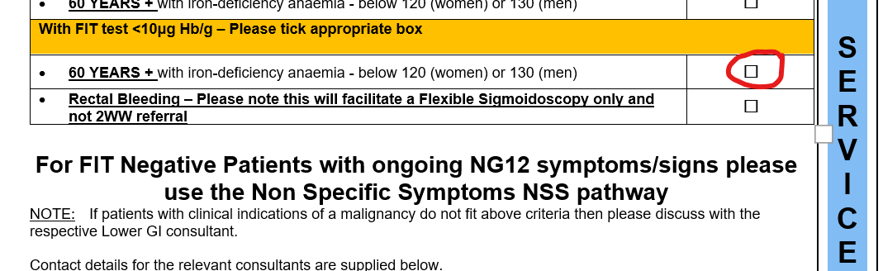

Slide 30
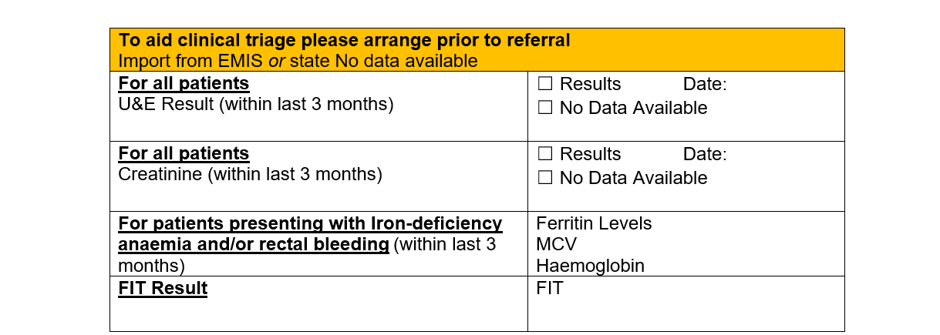

Slide 31
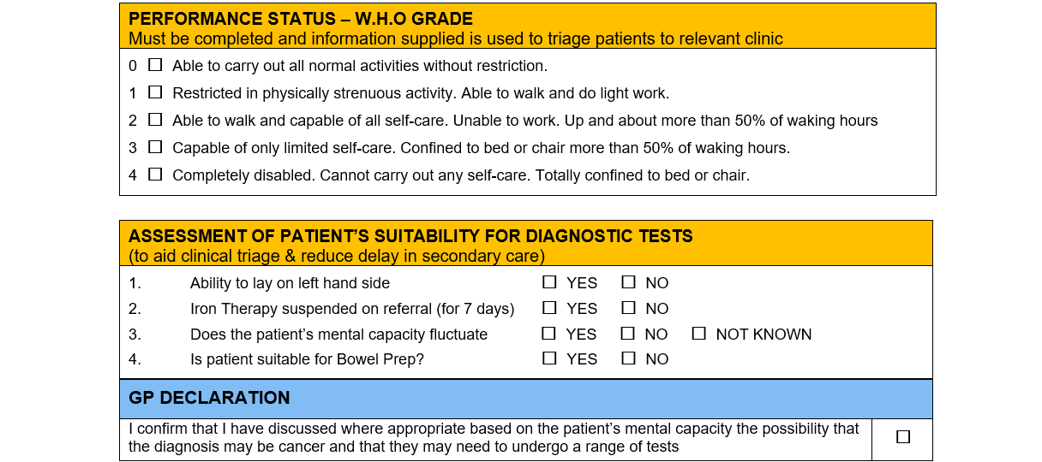
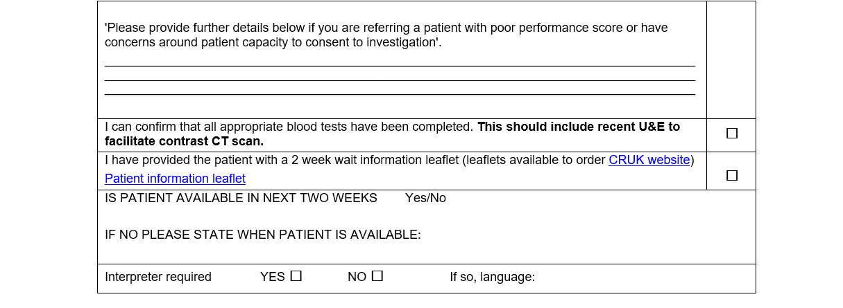

Slide 32
Quality of Referral
Key Points to remember
  FIT
  Bloods
  One referral – seen examples of multiple sites and multi provider referrals recently
  WHO performance status plus additional patient information
  Anything that may be relevant to your patient

Slide 33
PATIENT ATTENDS GP, GP CONCERNED ABOUT LGI CANCER
Patient declined/Unable to do FIT
Patient presents with:
Unexplained Rectal Mass
Anal Ulceration/Mass
FIT test Spoilt or not completed
Test not returned
Day 21
Test not returned
Patient reminded (Day 7)
FIT test requested
LGI 2WW REFERRAL MADE
GP to make contact with patient for repeat
FIT results reviewed
GP contacts patient for repeat
POSITIVE FIT RESULT >10 ugHb/g (inc. IDA)
Please ensure the correct FIT code and the 2WW urgent LGI/Colorectal referral code has been added within the correct timelines
NEGATIVE FIT result <10 ugHb/g
Patient reviewed by GP
Remember, especially for young patients with bowel symptoms they may have IBD, hence do a Faecal Calprotectin and if positive refer to the urgent IBD pathway
GP not concerned about a cancer
Patient has IDA
Ongoing NG12 Symptoms
Unexplained PR bleeding
Patient doesn’t require a referral
LGI 2WW REFERRAL MADE
This document requires:
-timely turnaround of FIT results
-an active NSS pathway
-flexi sig pathway
NSS
Referral made
Advice &
Guidance/
Routine referral
LGI 2WW REFERRAL MADE
NSS
Referral made
Direct access Flexi Sig – Cancer Pathway Referral made
Patient safety netted in Primary Care

Slide 34
Where can you get support?

Slide 35
Advice and Guidance
Clinical leads identified on referral forms
ICB Cancer Transformation Team

Slide 36
What else are we looking at?
Future changes based on your feedback

Slide 37
Future Developments
  Online requesting via TQUEST due to be rolled out from end of October 23
  Measuring impact of FIT (national data submission)
  Review of patient cases

