Slide 1
What is safety netting and why is it important?

Slide 2
Why is safety netting important?
The non-specific nature of cancer symptoms is a key challenge to early diagnosis
Effective safety netting can:
  Help manage diagnostic uncertainty (‘vague symptoms’)
  Reduce delays*
  Help to diagnose cancer earlier
  Improve survival
  Reduce costs to the NHS
  DES/QOF
Notes:
#*Retrospective clinical reviews showed that one in four cancers diagnosed in England (2014) had an avoidable delay to their diagnosis, with nearly half (49%) of delays happening in primary care.
Swann R, Lyratzopoulos G, Rubin G, Pickworth E, McPhail S. The frequency, nature and impact of GP-assessed avoidable delays in a population-based cohort of cancer patients. Cancer epidemiology. 2020;64:101617.

Slide 3
Safety Netting Options
EMIS
PCIT
Arden’s

Slide 4
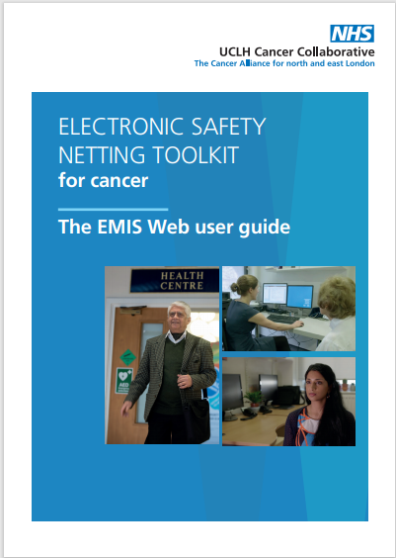
North Central London Cancer Alliance - Electronic Safety Netting Tool
North Central London CA Electronic Safety Netting Tool
The toolkit gives GP practices a template/form that schedules diary reminders in their system and reminds and alerts practice staff to follow up at a later date.
Location of toolkit on EMIS web
Guide for Clinicians
Guide for Admin Staff
Video User Guide

Slide 5
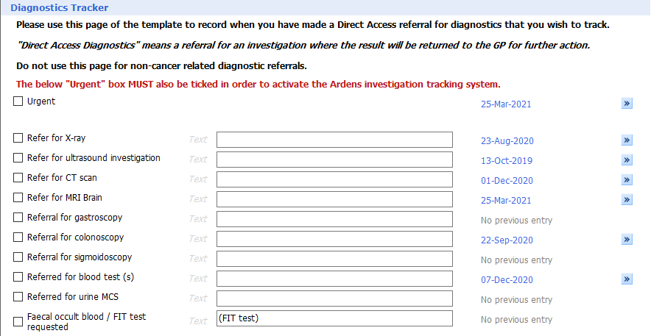
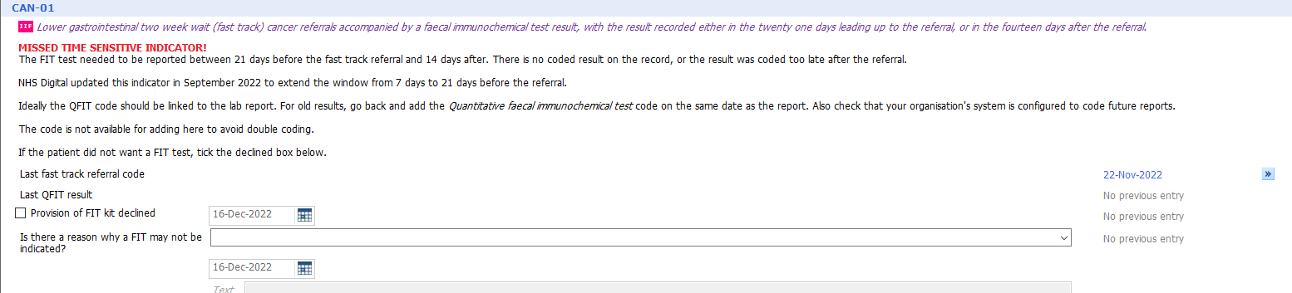
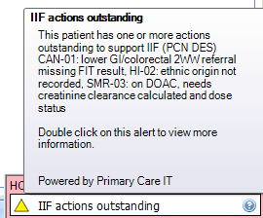
Arden’s / PCIT Safety Netting
Safety netting templates are also in Arden’s and PCIT programmes and enable user to follow up the FIT and 2WW referral
Ardens
PCIT

Slide 6
Safety Netting
- Ardens
Opens in web browser

Slide 7
Safety Netting
- Primary IT
Opens in web browser

Slide 8
Two important aspects for primary care
1. Fast track referral for suspected lower GI referral
  Follow up – FIT test requested on [insert date]
  Set date to send 2WW referral [2 weeks from now]
2. FIT
  Referred for Quantitative faecal immunochemical test (qFIT)
  Follow up – send 1st text immediately
  Schedule 2nd text in 5 days

Slide 9
Supporting Text Messages

Slide 10
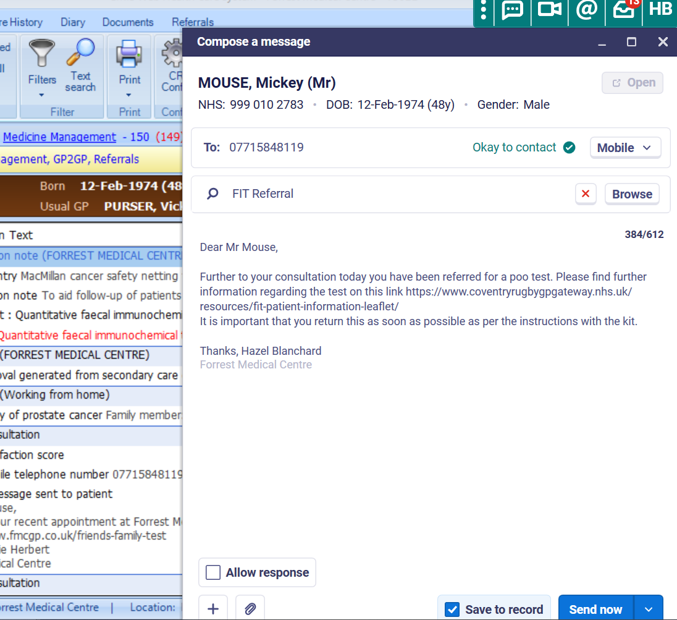
Supporting FIT Text messages prior to a TWW referral
Completed by Admin Team at the practices:
1st standard suggested text wording sent to patient when FIT referral done:
‘Dear X,
Further to your consultation today you have been referred for a poo test. Please find further information regarding the test on this link
https://www.coventryrugbygpgateway.nhs.uk/resources/fit-patient-information-leaflet/
It is important that you return this as soon as possible as per the instructions with the kit.
XXX Practice name’

Slide 11
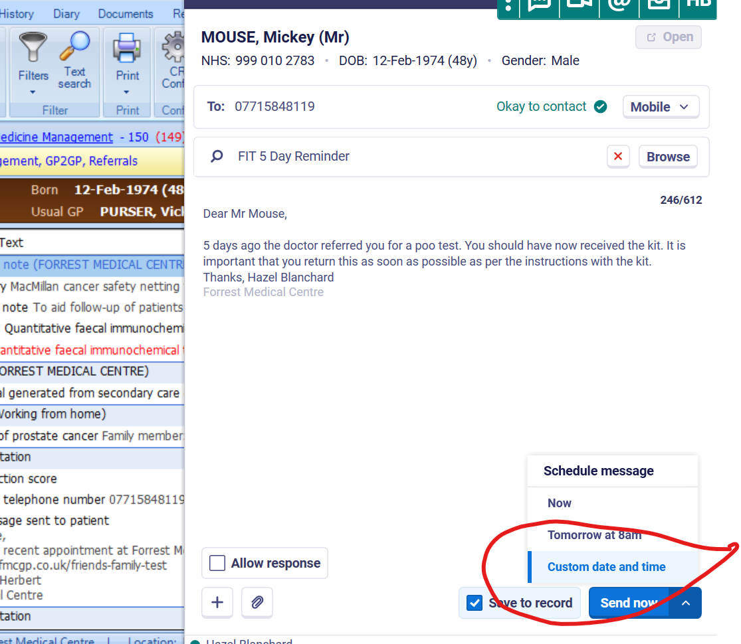
Supporting FIT Text messages prior to a TWW referral
At the same time Admin can custom set another text set for 5 days time:
Day 5 follow up Standard suggested text wording:
‘Dear X,
5 days ago the doctor referred you for a poo test. You should have now received the kit. It is important that you return this as soon as possible as per the instructions with the kit.
XXX Practice name’

